Slide 1
La sfida dell’ AI per il mercato assicurativo e gli impatti nella gestione del rischio
XXXI edizione del convegno RIB - ASSIGECO
Saint-Jean-Cap-Ferrat, 2 ottobre 2025
Antonia Di Bella

Slide 2
Iniziamo con la definizione
«sistema di IA»: un sistema automatizzato progettato per funzionare con livelli di autonomia variabili e che può presentare adattabilità dopo la diffusione e che, per obiettivi espliciti o impliciti, deduce dall'input che riceve come generare output quali previsioni, contenuti, raccomandazioni o decisioni che possono influenzare ambienti fisici o virtuali (art 3 del Regolamento UE 2024/1689)
Marvin Lee Minsky ha definito l’ AI : “the science of making machines do thing that would require intelligence if done by man”
Traditional AI
Generative AI
Analizza dati e fa previsioni
GenAI va oltre, poichè crea nuovi dati
Tuttavia bisogna considerare che, nella maggioranza dei casi:
Sono modelli generati internamente
Possono essere modificati autonomante
Hanno un elevato livello di explainability e possibilità di misurare i bias del modello
Sono modelli costruiti da altri
Non possono essere modificati internamente
Ad oggi hanno una limitata possibilità di explainability
Il risultato deve essere supervizonato dall’uomo

Slide 3


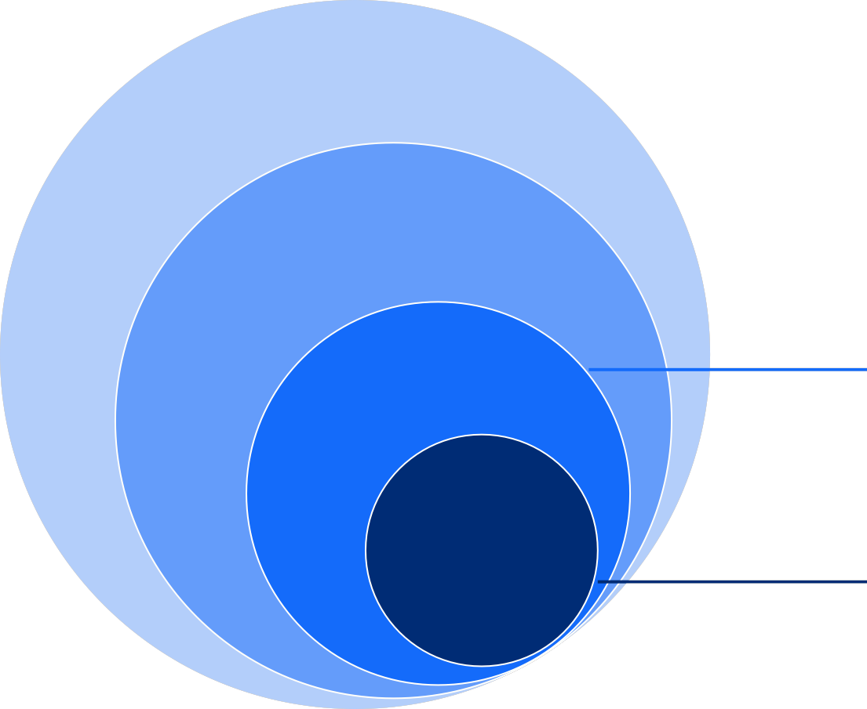

GENAI come una SUB-DISCIPLINa dell’ AI
Techniques to create systems that think and act like humans
Artificial Intelligence
Pattern recognition
Algorithms that improve in performance as they are exposed to more data
Machine Learning
Deep Learning
Use of deep neural networks to learn general patterns in (vast amounts of) structured and unstructured data (e.g. tabular data, images, audio, videos)
Deep Learning
Generative AI
Subset of Deep Learning to generate content, typically leveraging pre-trained knowledge and unstructured data
GenAI

Slide 4
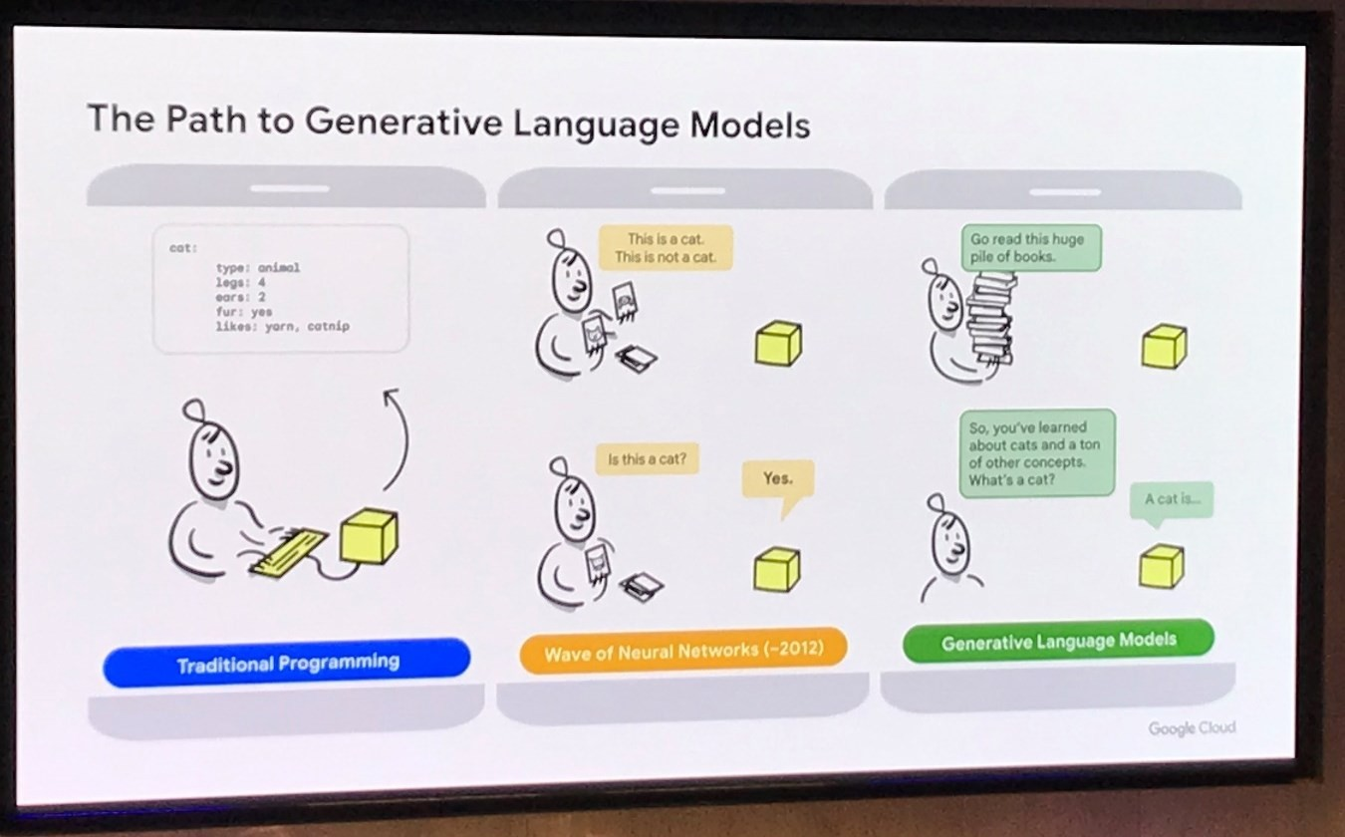
Dalla Traditional AI alla GenAI
Programmazione tradizionale
AI che si avvale di Deep Laearning e Neural networks
GenAI che si avvale di Large Language Models - LLM
1
2
3

Slide 5
GENERATIVE AI VERSUS TRADITIONAL AI
THE BASIC CONCEPTS
TRADITIONAL AI
VS
GENERATIVE AI
Description | Advanced analytical techniques relying on different algorithms and large organised data sets | A new field of AI with the ability to generate outputs in text and other mediums
Example methods | Regression, classification and advanced analytics Voice recognition Natural Language Processing (NLP) | Generative Pre-trained Transformer (GPT) to generate text also called Large Language Model (LLM). Generative Adversarial Network (GAN) to generate images Diffusion model to generate images
Trained for | Accuracy | Credibility
Use cases | Large data set analysis and data quality improvement Forecasting Pattern recognition and clustering incl. identification of outliers Data-driven decisioning Text or voice analysis Customer or transaction analytics | Writing first drafts of content Creating prompts for other Generative AI tools (e.g., Midjourney design prompts) Generating code for software development and software translation Assisting in creative work through idea exploration Contextualising and personalising content
7

Slide 6


KEY RISKS della GENAI (1/2)
THE BASIC CONCEPTS
 | Risks | Description | Examples
 | Misinformation and misuse | GenAI models may generate false or misleading outputs framed in a high confidence way. Misinformation or hallucinations can occur due to the inherent complexity of the model and the data it has been trained on. | The model produces a false response which is then used in downstream business processes leading to operational risk.
 | Bias and fairness | GenAI often relies heavily on vast amounts of text data scraped from the internet or company documents, which can inadvertently encode biases present in the data. | The language and tone used in the response may be more assertive depending on the context.
 | Input sensitivity | GenAI output is typically unpredictable and highly sensitive to the input prompt. This sensitivity can make it difficult to control or predict the behaviour of the model, especially in applications where precise outputs are required. | Changes in the wording of a prompt leads to a different outcome. Repeating the same question can lead to a different result depending on the conversation history.
 | Knowledge grounding and recall | Base LLMs (e.g. GPT-3.5) have extensive implicit knowledge about the world, but don’t know what they know. The models hence lack any sense of truth and a grounded knowledge base. Furthermore they often miss up-to-date domain knowledge of sufficient high quality relevant to the business use. The model might not use the relevant knowledge for responding to a user prompt. | When asking base LLMs questions about regulations, it likely cannot provide the reference where it found the answer. When asking questions about specific historic events, the model may produce a response that lacks accuracy and coherence.
6

Slide 7

KEY RISKS OF GENAI (2/2)
THE BASIC CONCEPTS
 | Risks | Description | Examples
 | Explainability and transparency | Although predictive AI models can have low explainability, GenAI models are particularly opaque in how they generate their outputs, making it difficult to identify root causes of errors and to predict potential mistakes. | In summarization tasks it might not be clear how it arrived at that specific summary, what factors it considered or what it overlooked. Similar to the examples in ‘Knowledge grounding and recall’, it cannot provide references it used to come up with an answer.
 | Accuracy, quality and reliability/ performance degradation | GenAI is optimised to work out probable or realistic sounding answers, rather than giving a calculated ‘right’ answer. For example GenAI models are generally not suited for numerical calculation tasks. Furthermore, performance of LLMs may vary or degrade over time due to various factors. | GPT-3.5 cannot correctly answer “Can you calculate 65-3+3%-3”. Lexical ambiguity of the same words that have different meaning. For example premium (insurance vs quality mark-up).
 | Data privacy | Data for training GenAI models, may include personal or sensitive information. As GenAI models can memorize text patterns, there's an increased risk of inadvertently revealing private information or generating content that compromises individuals’ or company privacy. | An application trained on claims data that contains personal information should only be used by authorised employees. Pasting company data in non-company approved chatbots.
7

Slide 8

LARGE LANGUAGE MODELS IN INSURANCE
POTENTIAL USE CASES
The insurance industry faces numerous complex and time-consuming procedures that can benefit greatly from artificial intelligence. Having industry-focused LLMs help automate various aspects of insurance operations, offering increased efficiency, accuracy, and cost savings.
Regulatory Compliance
Automation of regulatory compliance processes by analyzing regulatory documents, identifying relevant clauses, and ensuring adherence to compliance requirements minimizing manual effort in compliance monitoring
Generation of reports and documentation
Support to the process of document, contract or report creation, also based on predefined templates, helping in streamlining the process
Claims handling
Claims handling is a process that is rich in unstructured textual data. LLMs can be fine-tuned to help with tasks such as data or text classification, information extraction and generation of a draft responses requesting missing information in the claim reports
Coding assistant
Writing a new code or transforming an old one
can become faster and be done more efficiently
Fraud detection
Pattern recognition enhancement and more advanced text analysis can result in a reduction of false positives and false negatives results and improve the whole outcomes of a fraud detection model

Slide 9






Perché l’AI deve essere regolamentata?
Perchè
Principale regolamentazione sull’ AI
Ex-post , dopo gravi incidenti
Ex-Ante when the risk is very serious
Ex-Ante , quando il rischio è molto alto
AI Act
Promoting the use of AI that is safe, respects human rights, and protects health, safety, and the environment.
SS 1/23
Model Risk Management explicitly applying on AI
E23 comes into force in Sept 2025
Model Risk Management
SFC (Securities and Futures Commission) has issued a
circular: comprehensive guidelines & expectations regarding the responsible use of gen AI.
SR11-7
Model Risk Management with OCC clarifying that the principles apply on AI
Quando è necessario intervenire?
Discussions around the exclusion of logistic regressions from the AI ACT
PRO’s Potential issues
Quando gli operatori non si autoregolano

Slide 10
Opinion EIOPA on AI Governance and Risk Management
L’Opinion è rivolta ai regolatori nazionali con l’obiettivo di chiarire come interpretare le disposizioni esistenti del diritto assicurativo (IDD, Solvency II, DORA) nel contesto dell’uso di sistemi IA.
Non introduce nuovi obblighi di legge, né amplia l’ambito dell’AI Act o delle direttive assicurative; nelle intenzioni di EIOPA è più un documento di “supporto / interpretazione / orientamento” (“supervisory expectations”) rispetto a ciò che le imprese devono fare per essere conformi.
L’Opinion si applica a sistemi IA utilizzati nell’assicurazione non già classificati come “prohibited” o “alto rischio” secondo l’AI Act, per evitare sovrapposizioni normative.
Per i sistemi ad alto rischio / proibiti, l’AI Act già impone requisiti stringenti, che restano validi.
.

Slide 11
Opinion EIOPA su AI Governance and Risk Management
Principi chiave e aspettative di supervisione EIOPA propone che i regolatori nazionali promuovano / richiedano che le imprese adottino, per gli usi dell’IA, un quadro di governance e gestione del rischio basato su questi elementi:
Approccio basato sul rischio & proporzionalità
Governance interna
Data governance
Documentazione / record-keeping
Trasparenza & spiegabilità (explainability
Supervisione umana / intervento umano
Cyber sicurezza, robustezza e test del sistema
.

Slide 12
Grazie!

